Slide 1
Cain and Abel
Genesis 4:1-27

Slide 2
Introduction
the spread of sin
people became more wicked
Verses 1-16 the Fall affected Adam, Eve and their children
Verses 17-26 trace Cain and Seth’s descendants
the chapter begins and ends with the subject of worship

Slide 3
I. The murder of Abel
Genesis 4:1-8
4:1 “Now Adam knew Eve his wife”
The Hebrew term “knew” speaks of intimate personal relationship.
The Bible is silent about how many children they had and when they had them.

Slide 4
I. The murder of Abel
“Cain” The name “Cain” (qayin) is a sound play on the Hebrew word “gotten” (qaniti).
Some assert that Eve had previous daughters and that this was the first male.

Slide 5
I. The murder of Abel
4:2 “And again, she bore his brother Abel.”
“Abel” The Hebrew term means “vain,” “vapor,” or “vanity” (Eccl. 1:2).
this may reflect
Eve’s discouragement about her mortal condition or
a prediction about the shortness of his life;

Slide 6
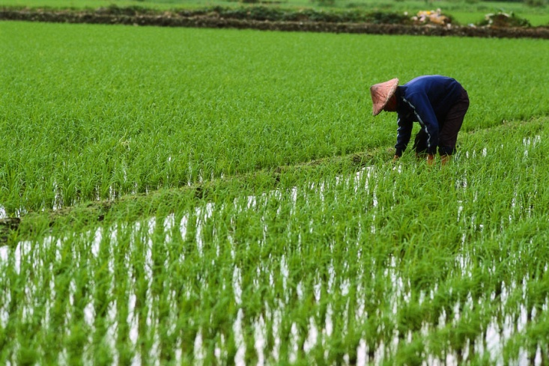
I. The murder of Abel
"Now Abel was a keeper of sheep, and Cain a worker of the ground."
Adam had, no doubt, already commenced both occupations.
Agriculture can never be entirely separated from the rearing of livestock.

Slide 7
I. The murder of Abel
Agriculture can never be entirely separated from the rearing of livestock.
sheep do not thrive without human protection and care

Slide 8
I. The murder of Abel
4:3 “In the course of time Cain brought to the LORD an offering of the fruit of the ground,”

Slide 9
I. The murder of Abel
4:4 “and Abel also brought of the firstborn of his flock”
Abel brought the best of his flock, which showed an attitude of faith and respect.
We must be careful of reading too much into the text.

Slide 10
I. The murder of Abel
“And the LORD had regard for Abel and his offering”
Why did God "have regard" for Abel's offering and not Cain's (v. 4)?
Heb. 11:4 By faith Abel offered to God a more acceptable sacrifice than Cain, through which he was commended as righteous, God commending him by accepting his gifts. And through his faith, though he died, he still speaks.

Slide 11
I. The murder of Abel
The answer may lie in one or more of the following explanations.
Abel's attitude reveals his faith.
2. Others say Abel's faith is evident in his bringing the best of the flock (v. 4)
3. Many believe that Abel realized the need for the death of a living substitute to atone for his sins, but Cain did not.

Slide 12
I. The murder of Abel
“So Cain was very angry”
Notice that he is angry at God but he will take his anger out on his brother.

Slide 13
I. The murder of Abel
4:6 “Why are you angry”
God questioned Cain, as He had Adam and Eve (cf. 3:9, 11), to elicit Cain's admission of sin with a view to repentance.

Slide 14
I. The murder of Abel
4:7 “sin is crouching at the door
I Pet. 5:8 Be sober-minded; be watchful. Your adversary the devil prowls around like a roaring lion, seeking someone to devour.

Slide 15
I. The murder of Abel
“Its desire is for you”
It shows that the purpose of evil is our destruction.
“but you must rule over it”

Slide 16
I. The murder of Abel
4:8 “Cain spoke to Abel his brother”
Some assert that Cain told Abel about what God had said in vv. 6 and 7.
Others assert that Cain told Abel a lie in order to lure him into the field so that he could kill him which would refer to premeditated murder.

Slide 17
I. The murder of Abel
The Apostle John revealed the reason Cain killed Abel in 1 John 3:12: We should not be like Cain, who was of the evil one and murdered his brother. And why did he murder him? Because his own deeds were evil and his brother’s righteous.
Abel's attitude of faith in God resulted in righteous works that produced guilt in Cain.

Slide 18
II The Punishment of Cain
Genesis 4:9-16
4:9 “am I my brother’s keeper
The term “keeper” can mean “shepherd” which may be a play on the occupation of Abel.

Slide 19
II The Punishment of Cain
4:10 “The voice of your brother’s blood is crying to me from the ground”
Lev. 17:11 For the life of the flesh is in the blood, and I have given it for you on the altar to make atonement for your souls, for it is the blood that makes atonement by the life.

Slide 20
II The Punishment of Cain
4:11 “now you are cursed from the ground”
With Adam’s sin the ground was cursed.
It is significant that Cain, being a farmer, can no longer use this as his occupation.

Slide 21
II The Punishment of Cain
Cain's punishment consisted of his being banished from God's presence and unable to enjoy his family's company and the fruitfulness of a settled life (vv. 11-12, 14).
He would have to wander from place to place seeking food rather than living a sedentary life.

Slide 22
II The Punishment of Cain
4:13 “My punishment is greater than I can bear”
Cain is not sorry for his act but he is sorry for its consequences.
4:14 “driven me today away from the ground” This is the physical result of Cain’s sin while the next phrase “from your face I shall be hidden” is the spiritual result of Cain’s sin.

Slide 23
II The Punishment of Cain
“whoever finds me will kill me”
The context seems to imply that his own relatives, who would be “go’els” (blood avenger) for Abel, would kill him.
This would imply that Adam and Eve had many unnamed children.

Slide 24
II The Punishment of Cain
4:15 “vengeance shall be taken on him sevenfold”
“And the LORD put a mark on Cain”
This was either a sign of
God’s mercy amidst judgment or
(2) God’s sustaining His judgment through time.
Whatever it was, Cain's mark served to protect him as well as to remind him and others of his banishment.

Slide 25
II The Punishment of Cain
4:16 “Then Cain went away from the presence of the LORD”
“the land of Nod” “Nod” is a Hebrew term for “wandering” or “the land of wanderers.”
We do not know where this place is located but it is obviously more east of Eden than Adam and Eve had gone.

Slide 26
III. The Spread of Civilization and Sin
Genesis 4:17-26
Cain's wife (v. 17) was evidently one of his sisters or nieces (5:4).
God did not prohibit marrying siblings and close relatives until the Mosaic Law.

Slide 27
III. The Spread of Civilization and Sin
The marriage of brothers and sisters was inevitable in the case of the children of the first men, since the human race was actually to descend from a single pair.

Slide 28
III. The Spread of Civilization and Sin
Cain named his son Enoch.
He also gave the same name to the city which he built.
Centuries had already passed since the creation of man, and Cain's descendants may by this time have increased considerably in numbers.

Slide 29
III. The Spread of Civilization and Sin
Cain, who was to be a fugitive and a vagabond upon the earth, established himself in the land of Nod.

Slide 30
III. The Spread of Civilization and Sin
The powerful development of the worldly mind and of ungodliness among the Cainites was openly displayed in Lamech, in the sixth generation.
Lamech (v. 19) was the first bigamist. Bigamy was common in the ancient Near East, but it was never God's desire (2:24; Matt. 19:4-5).

Slide 31
III. The Spread of Civilization and Sin
We could paraphrase the idea in Lamech's mind as expressed in verses 23-24 more clearly as follows. "If I am threatened again, I will retaliate again, even more forcefully than Cain did."
The idea is this: whoever inflicts a wound or stripe on me, whether man or youth, I will put to death; and for every injury done to my person, I will take ten times more vengeance than that with which God promised to avenge the murder of my ancestor Cain.

Slide 32
III. The Spread of Civilization and Sin
The history, therefore, turns from them, to indicate briefly the origin of the godly race.
Seth's name, from the Hebrew verb translated "granted" and meaning "to set or place," expresses Eve's faith that God would continue to provide seed despite death.

Slide 33
III. The Spread of Civilization and Sin
Verse 26. "To Seth also a son was born, and he called his name Enosh" 'enowsh’ to be weak, faint, frail, designates man from his frail and mortal condition.
Ps 8:4 what is man that you are mindful of him, and the son of man that you care for him?
Ps 90:3 You return man to dust and say, "Return, O children of man!"
Ps 103:15 As for man, his days are like grass; he flourishes like a flower of the field;

Slide 34
III. The Spread of Civilization and Sin
In this name, therefore, the feeling and knowledge of human weakness and frailty were expressed and this feeling led to God, to that invocation of the name of the LORD which commenced under Enosh.

Slide 35
III. The Spread of Civilization and Sin
We have here an account of the commencement of that worship of God which consists in prayer, praise, and thanksgiving, or in the acknowledgment and celebration of the mercy and help of the LORD.

Slide 36
III. The Spread of Civilization and Sin
Cain's descendants took the lead in building cities, developing music, advancing agriculture, creating weapons, and spreading civilization.
However the descendants of Seth made an even more important advance, the worship of God.

Slide 37
Conclusion:
Cain was a man who did not care to please God.
Because he did not, God did not bless him as He did Abel who was a man of faith.
Cain's anger and jealousy over Abel's blessing brought disaster on himself.
God has preserved his example to help us avoid it.
Those who worship God must have as their goal to please Him rather than letting envy and hatred ruin their lives.

