Slide 1
Noah and the Flood
Genesis 6:1-9:17

Slide 2
Introduction
God ensured that men possessed the rules
men were created as free moral agents
Humankind set its face against God
scientists believed in a universal Flood
religionists also have opposed a global Flood
Christians attempting to harmonize the Bible with science
a lightning rod for controversy

Slide 3
Introduction
Biblical Flood in the days of Noah has become a great divide
the central issue is not what current “evolutionary geology” decrees
the issue is what the Bible actually says
God’s Word speaks plainly of a worldwide Flood
The evidences to that effect from both Scripture and science are overwhelming

Slide 4
I. THE REASON FOR THE FLOOD 6:1-8
fallen angels (“sons of God”) mated with women of the earth (“daughters of men”)
Angels are spirit beings (Hebrews 1:14).
Christ said angels do not marry (Matthew 22:30; Mark 12:25; Luke 20:34-35).

Slide 5
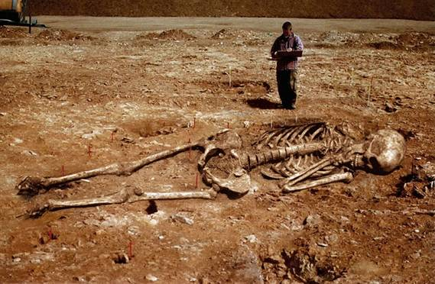
I. THE REASON FOR THE FLOOD 6:1-8
nothing in Genesis 6:4 that indicates the Nephilim were offspring of the marriages
The word “Nephilim,” usually identified as “giants

Slide 6
I. THE REASON FOR THE FLOOD 6:1-8
the godly lineage of Seth, called “sons of God”, began to pursue fleshly interests, and so took wives of “the daughters of men,” i.e., those who were unbelievers
it was this sinful trend that ultimately brought the Flood
Can angels drown?
Paul spoke of such evil consequences in 1 Corinthians 15:33 when he wrote: “Be not deceived: evil companionships corrupt good morals.”

Slide 7
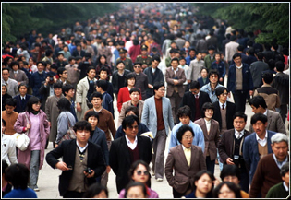
I. THE REASON FOR THE FLOOD 6:1-8
the time span involved was approximately 1,656 years
1,656 years would be enough time to produce an enormous population

Slide 8
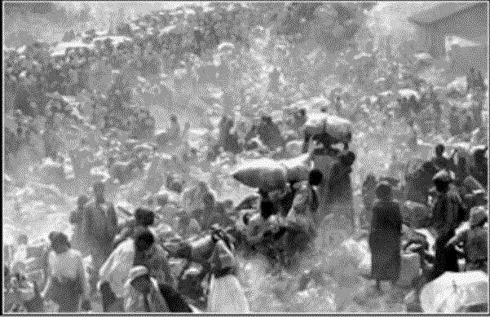
I. THE REASON FOR THE FLOOD 6:1-8
the century between 1830 and 1930, the world population doubled in number (i.e., it increased by about 850 million people)
Some have objected to the suggestion that mankind covered the globe

Slide 9
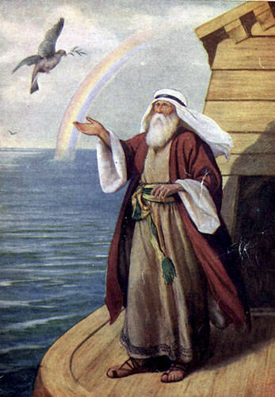
II. The Flood 6:9—8:22
first time the important words "righteous" and "blameless" appear in the Bible
“Noah was a just man”
Noah is described as being “perfect in his generations.”
Noah “walked with God”

Slide 10
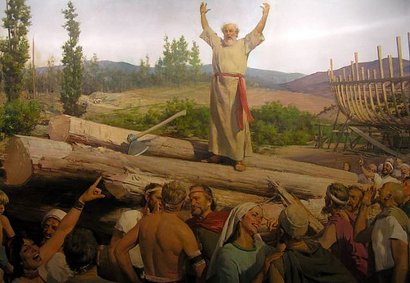
II. The Flood 6:9—8:22
a “probationary period” of 120 years was established by God
Noah preached to the people of his generation (1 Peter 3:18-20) and carried out the commands of God regarding the building of the ark (Genesis 6)

Slide 11
II. The Flood 6:9—8:22
After approximately 100 years, Noah’s work was completed
Noah’s only “converts” appear to have been members of his own family group

Slide 12
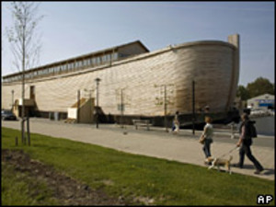
II. The Flood 6:9—8:22
The ark was about 450 feet long, 75 feet, and 45 feet high
the capacity of approximately 569 railroad boxcars

Slide 13
II. The Flood 6:9—8:22
about 35,000 vetebrate animals within Noah’s ship
“kind” is a broader category than a “species”
A standard railroad freight car can accommodate approximately 240 sheep

Slide 14
II. The Flood 6:9—8:22
The ark probably looked more like a rectangular box than a ship.
its purpose was to stay afloat, not travel from one destination to another
Modern ocean-going tankers and aircraft carriers have a similar scale of dimensions
type of wood out of which Noah made it is unknown

Slide 15
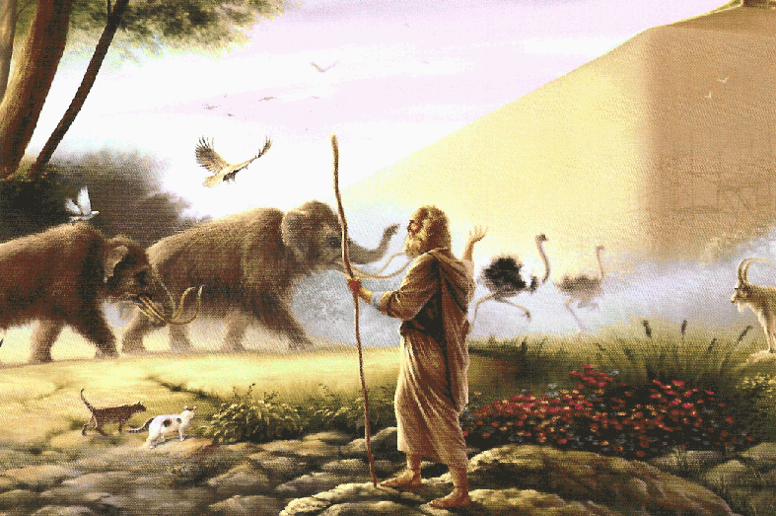
II. The Flood 6:9—8:22
Genesis 6:19-20 makes it clear that God caused the animals to “come unto Noah.”
God graciously invited Noah to enter the ark with his family (7:1).
God extends the invitation to people

Slide 16
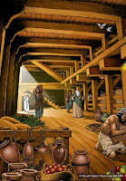
II. The Flood 6:9—8:22
God was “with them” and “remembered them.”
a year-long hibernation process on the animals

Slide 17
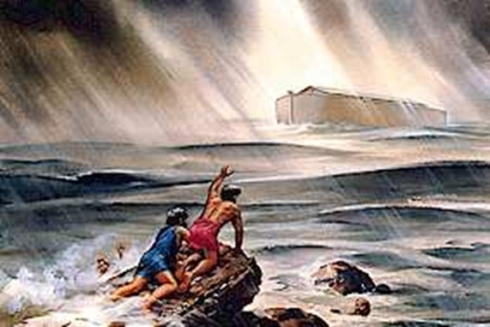
II. The Flood 6:9—8:22
The evidence for a global Flood is overwhelming.
AII the high mountains, that were under the whole heaven were covered. . . And all flesh died that moved upon the earth” (Gen. 7:19,21)
A portion of the Flood waters came as a result of the fountains of “the great deep”

Slide 18
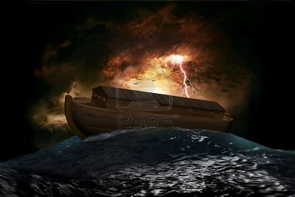
II. The Flood 6:9—8:22
3. why did God have Noah work for more than a century constructing an Ark?
4. Noah and the other inmates of the Ark were in the vessel for more than a year

Slide 19
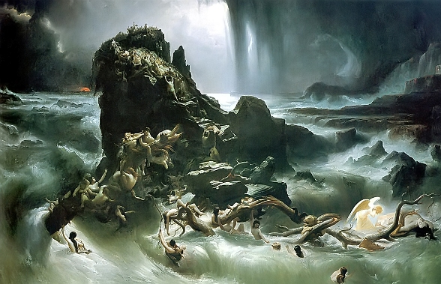
II. The Flood 6:9—8:22
5. ancient traditions of a Flood that consumed the entire earth
6. The Flood was designed as a punishment against the worldwide corruption of humanity

Slide 20
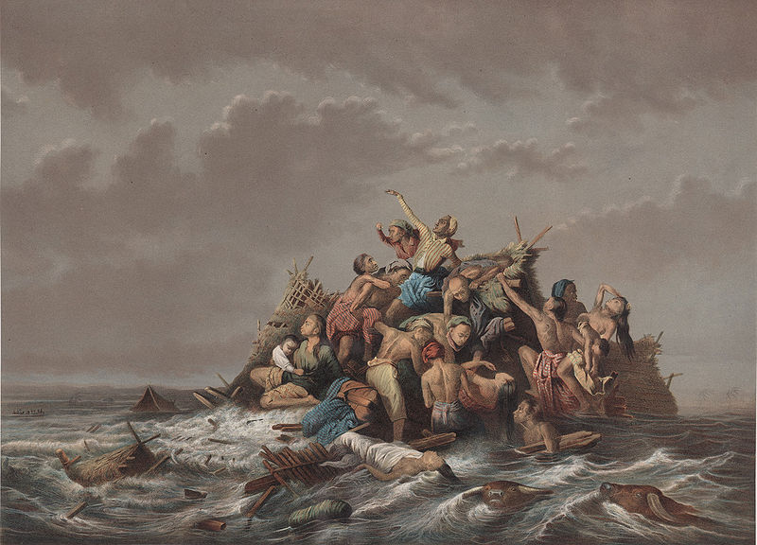
II. The Flood 6:9—8:22
7. God made a covenant with Noah that no flood, of this scope, would occur ever again
8. Peter charges that these scoffers “wilfully forget” that the “world that then was, being overflowed with water, perished” (2 Peter 3:6)

Slide 21
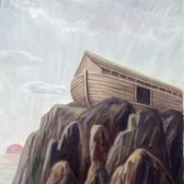
II. The Flood 6:9—8:22
God remembered someone, meant God extended mercy
Mt. Ararat lies on the border between Turkey and Armenia
Noah's "altar" is the first altar mentioned in the Bible
a burnt offering made atonement
Noah's sacrifice represented all humankind

Slide 22
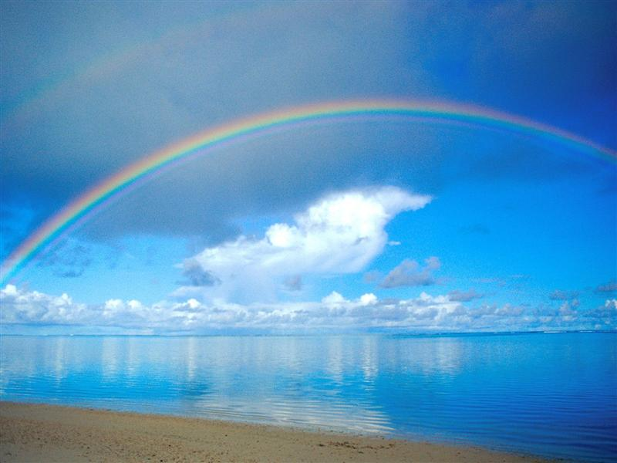
III. THE RAINBOW COVENANT AND ITS IMPLICATIONS
God established human life anew on the earth
He would not destroy His creation again with a flood
a rainbow in the heavens as a sign of the permanency of that promise

Slide 23
III. THE RAINBOW COVENANT AND ITS IMPLICATIONS
God again commanded Noah and his sons to fill the earth
God gave Noah permission to eat animals (9:3)
prohibit the eating of animal blood

Slide 24
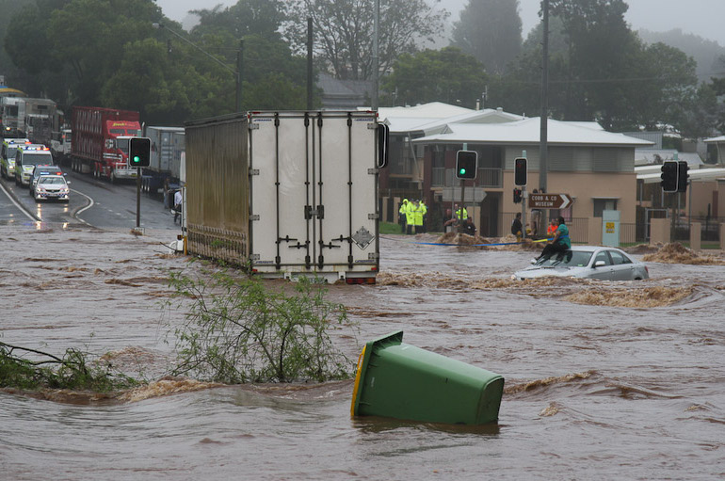
III. THE RAINBOW COVENANT AND ITS IMPLICATIONS
God promised never again to destroy “everything living” and “all flesh” by a flood
He set a rainbow in the heavens
If the Genesis Flood were merely a local event, then God has broken His covenant repeatedly
Advocates of the local flood theory have God breaking His promise

Slide 25
CONCLUSION
the Flood is one of the most prominent stories in the Bible
next to Creation, the Flood of Noah’s day is the greatest single geological event
repeated references to the Flood account within the Old Testament
Jesus and the writers of the New Testament often alluded to Noah and the Flood
there is no other event except the Fall which has had such a revolutionary effect

Slide 26
CONCLUSION
theologians and scientists of the past attributed many of the Earth’s features to the Flood of Noah
that no longer is the case
the conflict between evolutionary geology and the inspired Word of God
it is impossible to correlate the Bible with evolutionary geology
those who do not believe in God, delight in ridiculing the Flood account

Slide 27
CONCLUSION
Was the Flood universal in scope, or was it merely a local flood?
Is the account in Genesis 6-9 of the Flood the record of an actual historical event?
examine the biblical and scientific evidence that supports the Genesis Flood
never willing to compromise inspired testimony
the main concern, as always, should be what do the Scriptures teach

