Slide 1
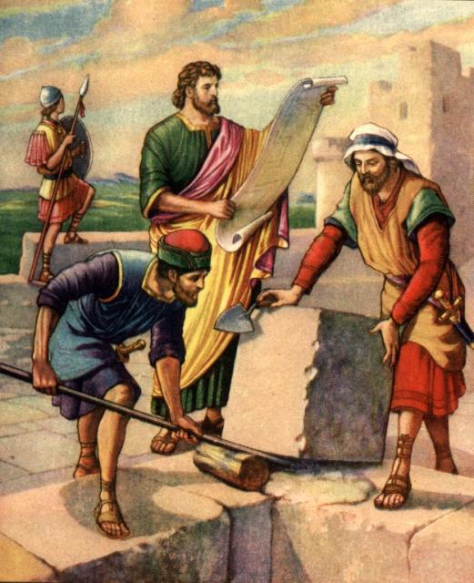
Nehemiah
The Champion Builder

Slide 2
Introduction
In the history of the nation of Israel, after the golden reigns of David and Solomon, for the following 325 years there had been steady decline in godliness.
Northern Israel had a continuous succession of bad kings such as Ahab with Jezebel, until in 722 B.C. the kingdom was captured by Sennacharib and deported to Assyria.

Slide 3
Introduction
Southern Judah did have some godly kings such as Asa, Jehosophat, Hezekiah, and Josiah, but also the worst of all, Manasseh for 55 years, that included child sacrifices.
There finally came a succession of bad kings that culminated in the Babylonian Captivity under Nebuchadnezzar, and the destruction of Jerusalem, including the Temple, in 586 BC.

Slide 4
Introduction
This Babylonian Exile, of 70 years, lasted until the proclamation of Cyrus, the Persian who, in 538 B.C., issued a decree allowing the captives to return to rebuild the Temple (Ezra 1:1-3).
The first contingent of 50,000 returned in 537 B.C. under Zerubbabel, the head of the tribe of Judah, for the purpose of rebuilding the Temple.

Slide 5
Introduction
The second contingent of 2,000 returned in 457 B.C. under Ezra the Scribe, for the purpose of establishing pure worship and marriage reform.
The third contingent returned in 445 B.C. under Nehemiah, a cupbearer of King Artaxerxes, for the purpose of rebuilding the walls of Jerusalem, and again, the establishment of reform.

Slide 6
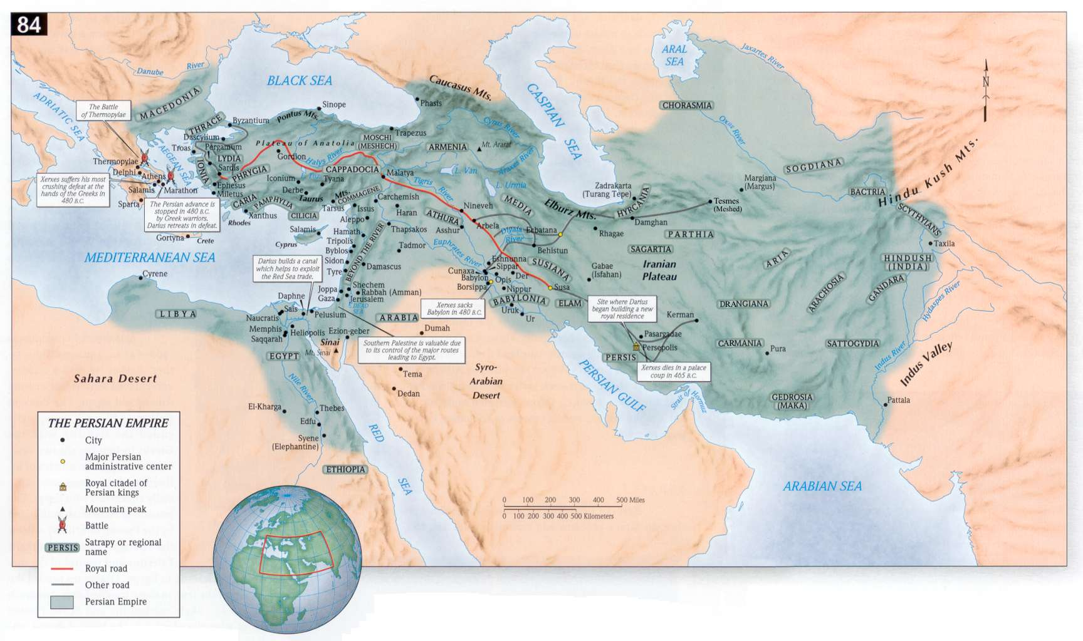
The Persian Empire

Slide 7
Jerusalem News 1:1-3
The book is introduced as the words of Nehemiah, son of Hachaliah.
Nehemiah received a visit from Hanani who is identified as one of his brothers (cf. 7:2) who came with other men from Judah.
The city wall was broken down and the gates burned with fire. The Babylonians had done this when they overthrew the city (2 Kings 25:8-10; 2 Chron. 36:19; Jer. 52:12-14).

Slide 8
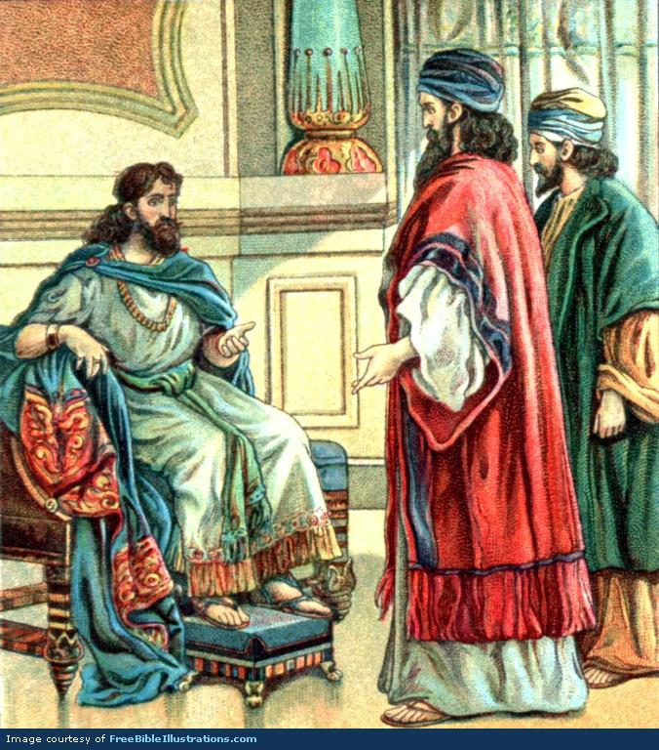
Nehemiah’s Response 1:4-11
His approach toward God, v. 4.
weeping
mourning
fasting
Praying
Step#1 in Being a Builder for God:
Really Care and Desire To See God’s Work and God’s People Prosper.

Slide 9
Nehemiah’s Response 1:4-11
His appreciation of God, vs. 5-6a.
His confession toward God, vs. 6b-7.
Israel has sinned collectively, v. 6b.
The “sons of Israel,” have primarily sinned
against God in His holy heaven, v. 4, and not
just one another (Ps. 51:4).

Slide 10
Nehemiah’s Response 1:4-11
Israel has sinned profoundly, v. 7.
The “sons of Israel, have sinned specifically
against the revealed law of Moses, the Word of
God, “very corruptly/wickedly.” No excuses are
offered, no minimizing.
His supplication toward God, vs. 8-11.
Remember your promise of dispersal, v. 8.
Remember your promise of reconciliation, v. 9.

Slide 11
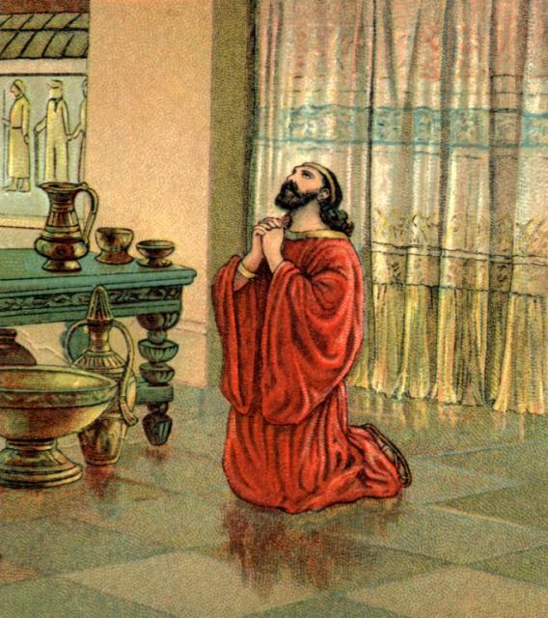
Nehemiah’s Response 1:4-11
Remember Your possession, v. 10a.
Remember Your redemption, v. 10b.
Remember the honor of your name, v. 11a.
Step #2 in Being a Builder for God:
Seek God’s Help in Prayer and Be Sure Our Intentions Please Him.

Slide 12
Nehemiah’s request 2:1-8
Nehemiah’s courage before a watching pagan ruler, vs. 1-3.
Nehemiah’s courage before a listening pagan ruler, vs. 4-8.
He prays first, as is his customary priority v. 4.
He pleads faithfulness in service v. 5a.
He pleads the rebuilding of Jerusalem v. 5b.
He pleads before the Queen v. 6a.

Slide 13
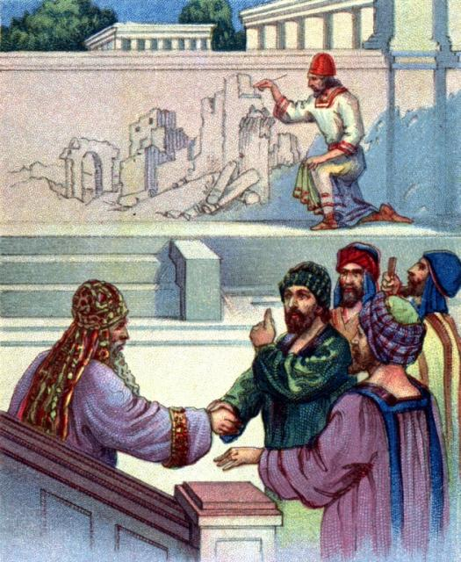
Nehemiah’s request 2:1-8
He pleads having made preparation vs. 6b-7.
He pleads for material support v. 8a.
Step 3 in Being a Builder for God: Where Possible, Obtain Permission and Assistance from People in Authority
Step #4 in Being a Builder for God: Develop a Plan of Action

Slide 14
To Jerusalem 2:9-20
Nehemiah’s courage before cooperating pagan governors, vs. 9.
Nehemiah’s confrontation with a hostile world, v. 10.
A godly analysis of the present, vs. 11-16.
It is filtered through what, “God was putting into my mind, v. 12.
It is focused on present desolation, vs. 13-15.

Slide 15
To Jerusalem 2:9-20
A godly proposal for the future, vs. 17-18.
Let us no longer be a reproach, v. 17.
Let us arise and build, v. 18.
An ungodly objection, “What is this thing you are doing?” v. 19.
A godly rejoinder, “The God of heaven will give us success,” v. 20.

Slide 16
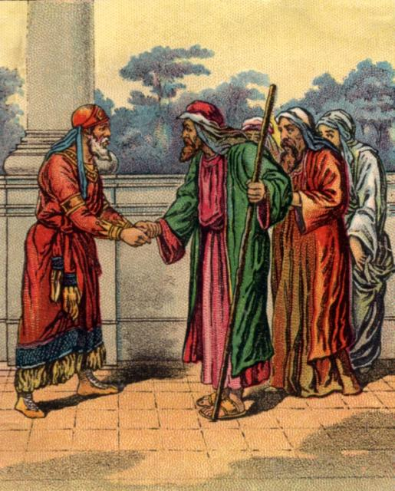
The return to Jerusalem Nehemiah 2:9-20
Step #5 in Being a Builder for God: Motivate People to Work
Step #6 in Being a Builder for God: Resist Opposition

Slide 19
The workers and their work Nehemiah ch. 3
The leadership initiative, v. 1.
The infectious activity.
The division of labor.
Appointed gifts were employed v. 26
Learned gifts were employed vs. 8, 31
Natural gifts were employed v. 12

Slide 20
The workers and their work Nehemiah ch. 3
The priority of walls and gates.
Gates are necessary to regulate the entrance by the world and exit to the world.
Walls are necessary to resist the assaults of enemies.

Slide 21
Opposition to the work ch. 4
THE ENCOUNTER WITH CONSPIRACY, 4:1-9
The design of conspiracy.
Ridicule, vs. 1-3.
Contention, vs. 7-8.

Slide 22
Opposition to the work ch. 4
The defeat of conspiracy.
Through prayer, vs. 4-5, 9.
First Nehemiah prays himself, v. 4.
Second Nehemiah prays for a righteous cause, vs. 4-5
Third Nehemiah prays with the people of God, v. 9
Through perseverance, v. 6.

Slide 23
Opposition to the work ch. 4
THE ENCOUNTER WITH DISCOURAGEMENT, 4:10-23
The design of discouragement, vs. 10-12.
The indirect threat of failing strength, v. 10.
The direct threat of ambush, v. 11.
The direct threat of being surrounded, v. 12.

Slide 24
Opposition to the work ch. 4
The defeat of discouragement, vs. 13-23.
Strengthening of the ranks, v. 13.
Strengthening with exhortation, v. 14.
Strengthening with sword and trowel, vs. 15-18.
Strengthening with consolidation, vs. 19-20.
Strengthening with vigilance, v. 21-23.

Slide 25
Worker Strife ch. 5
The design of worldliness, vs. 1-5.
Food, v. 2.
Housing, v. 3.
Taxation, v. 4.
Family, v. 5.
The defeat of worldliness, vs. 6-19.
The necessity of condemnation, vs. 7-11.
The necessity of confession, v. 12.

Slide 26
Worker Strife ch. 5
The necessity of leadership example, vs. 13-19.
Godly leadership calls for commitment, v. 13.
Godly leadership does not take advantage, vs. 14-15.
Godly leadership does what it asks, vs. 16-17.
Godly leadership does not indulge itself, vs. 18-19.

Slide 27
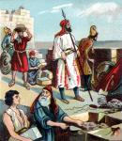
Worker Strife ch. 5
Step #7 in Being a Builder for God:
Rebuke Sin Among God’s People.
Step 8 in Being a Builder for God:
Set a Good Example and
Be Willing to Sacrifice.

Slide 28
Nehemiah Attacked 6:1-14
The plot to distract Nehemiah 6:1-4
The plot to discredit Nehemiah 6:5-9
The plot to deceive Nehemiah 6:10-14

Slide 29
Work Completed 6:15—7:4
Through perseverance in building 6:15-19.
Through the sealing of the city 7:1-4.

