Slide 1
The Lord’s House

Slide 2
What house was built?
Mark 6:2-3
John 2:19-21
Physical—or spiritual?

Slide 3
House #1: The Church
Matthew 16:16-19
1 Corinthians 3:10-11
Acts 20:28
Ephesians 1:22-23
Colossians 1:18
Romans 16:16

Slide 4
Our Attitude
Psalm 122
Acts 20:28; Titus 1:5-9; 1 Timothy 3:1-7
1 Timothy 3:8-13; Philippians 1:1
Acts 26:16-18; Romans 15:16; Ephesians 3:7; Colossians 1:23-25; 1 Timothy 4:6; 2 Timothy 4:2-5
Titus 2; 1 Timothy 5:1-2; 1 Corinthians 12

Slide 5
House #2: The Family
Matthew 19:4-6
Ephesians 5:22ff.
Ephesians 6:1-4
1 Corinthians 11:3

Slide 6
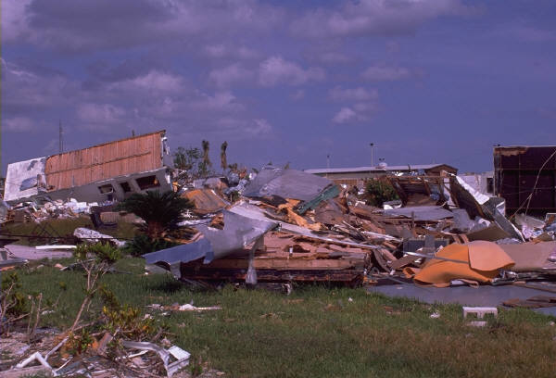
Conclusion
Psalm 127
Luke 6:46-49
Matthew 12:25

