Slide 1
The Tower of Babel
Genesis 11:1-9

Slide 2
Introduction
The second general rebellion of humanity against the Creator
The first ended in the destruction of the whole world in the waters of the Flood
This second instance, the Tower of Babel, ended in the confusion of tongues
Explains to God's people how God scattered the nations and why

Slide 3
Contradiction?
According to skeptics, Genesis 10:5, 20, and 31 contradict Genesis 11:1
Events recorded in Genesis 10-11 were not written chronologically
10:25, a man named Peleg (meaning “division”) “in his days the earth was divided.”
Division in Peleg’s day is linked contextually to the linguistic segregation at Babel

Slide 4
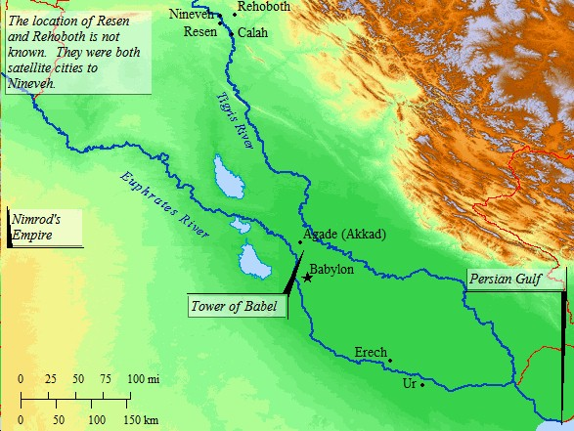
I. Conditions Prior to the Confusion of Tongues
Genesis 11:1, 2
Mankind came from Noah, all men spoke a common language
Common language made the people more capable of working together

Slide 5
I. Conditions Prior to the Confusion of Tongues
Nothing wrong with a common language
A plain in the land of Shinar, a spacious plain, able to contain them all, and a fruitful plain, able to support them all

Slide 6
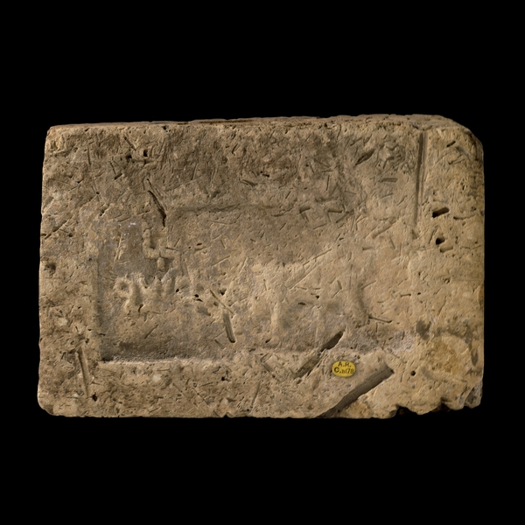
II. The Intentions of Man
Genesis 11:3
Absence of building stone on the plains of Shinar led to the brick industry
Slime (KJV) here is [~hemar], that is bitumen or asphalt

Slide 7
II. The Intentions of Man
Building projects used stone and mortar
Necessary to substitute fire-hardened brick for stone and asphalt for mortar

Slide 8
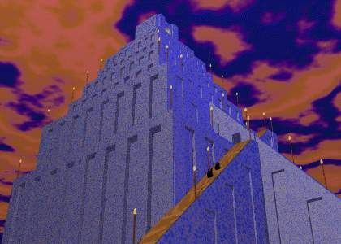
II. The Intentions of Man
Genesis 11:4
Strong religious flavor, men were trying to get to God by building a tower
A gate to the gods and a tribute to their idolatry

Slide 9
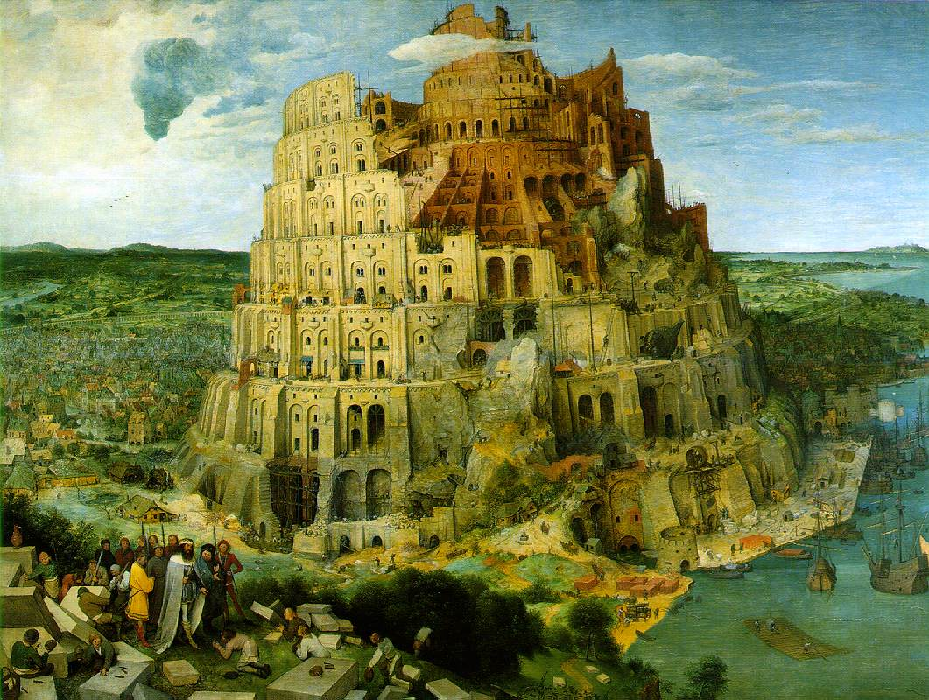
II. The Intentions of Man
“Its top in the heavens,” simply implies great height
Arrogance, rebellion, and pride

Slide 10
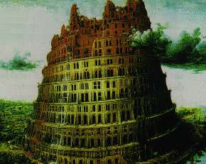
II. The Intentions of Man
People could not conceive of blessing and security coming as a result of dispersion
They placed their faith in bricks and asphalt

Slide 11
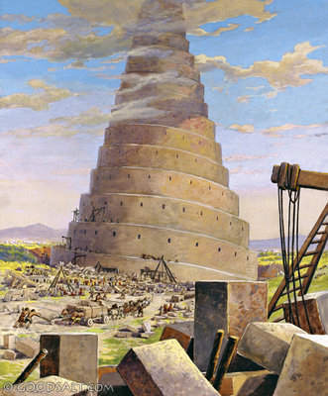
III. The Investigation of God
Genesis 11:5
God considered this event as a rebellion of all mankind
Appearance that God has let a situation get nearly out of control

Slide 12
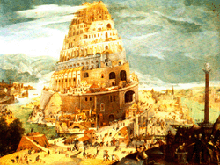
III. The Investigation of God
Man’s thoughts and efforts, no matter how lofty, are insignificant to God
The tower may seem to pierce the clouds, but to the almighty God it was a barely visible dot on the earth

Slide 13
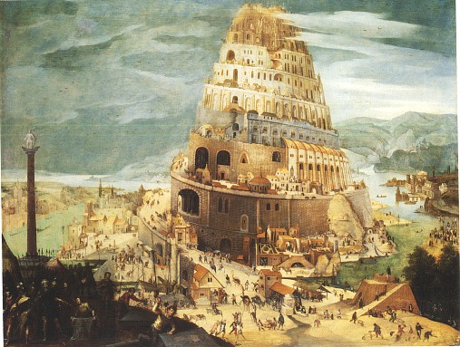
IV. God’s appraisal and purpose
Genesis 11:6
Evil does not lie in the fact that all men spoke one language
Completion of this city would in no way threaten the rule of God

Slide 14
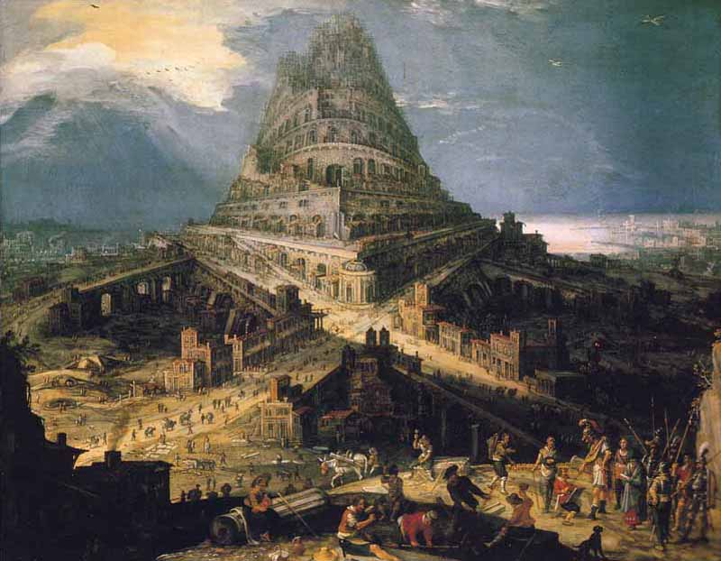
IV. God’s appraisal and purpose
Genesis 11:7
Plural form here the Godhead
The wonder of HOW God confounded languages, we have no information

Slide 15
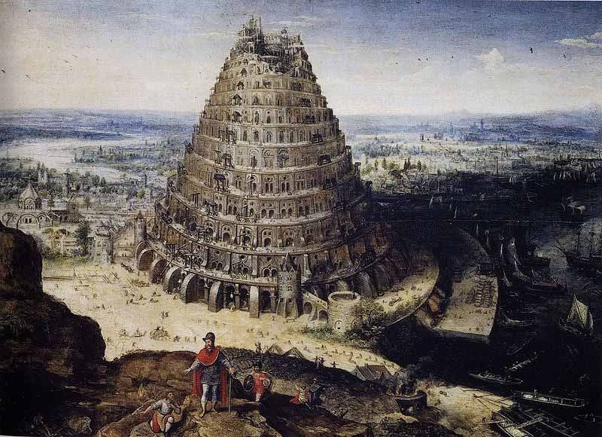
IV. God’s appraisal and purpose
Not the last visitation upon the conceited, lustful, self-worshippers
“On account of these the wrath of God is coming.” (Colossians 3:6)

Slide 16
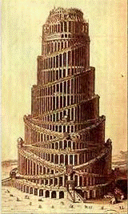
V. Conditions after the Confusion of Tongues
Genesis 11:8
God encouraged them toward the right decision
Genesis 11:9
The word [~balal] means to ‘confuse’

Slide 17
Babel is important
It explains the beginning of and reason for the various languages of mankind.
It explains the origin of the "races" within humankind.
The Babel story demonstrates the inclination of fallen man to rebel against God and to try to provide for his needs in his own way rather than by trusting and obeying God.

Slide 18
Babel is important
4. It illustrates that rebellion against God results in (a) broken fellowship with God and man, and (b) failure to realize God's intention for man in his creation, namely that he rule the earth effectively.
5. It provides the historical background for what follows in Genesis. Abraham came from this area.

Slide 19
Conclusion
Man’s plans will never thwart God’s purposes. God had commanded mankind to “fill the earth” (Genesis 9:1).
Unity is not the highest good, but purity and obedience to the Word of God.
Superficial relationships and artificial activity will inevitably miss the meaning of life.

Slide 20
Conclusion
(4) The Word of God, and not the works of our hands, is the only thing worthy of our faith.
God has now provided a salvation for men in the sacrificial death of Jesus Christ on the cross.
He has assured men that to as many as believe upon Him—repent of their sins, confess their faith, and are baptized— shall be saved.
And that is the only basis for hope beyond the grave.

