Slide 1
the faith of Abraham
Genesis 12:1-3

Slide 2
INTRODUCTION
Abraham had a faith which God declared to be the Christian’s model for faith.
The Christian’s understanding of God’s promise to produce a universal blessing through Abraham far exceeds Abraham’s understanding.
Yet, the best any Christian can hope to do is to equal the faith of Abraham.

Slide 3
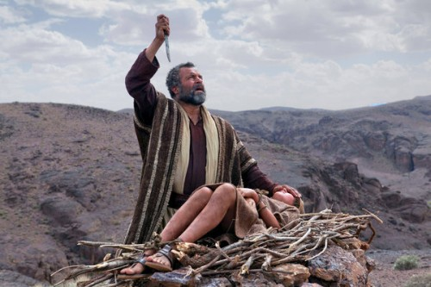
I. Abraham: A True Man of Faith.
The Faith of Abraham as a type:
Romans 4:16
James 2:19-22

Slide 4
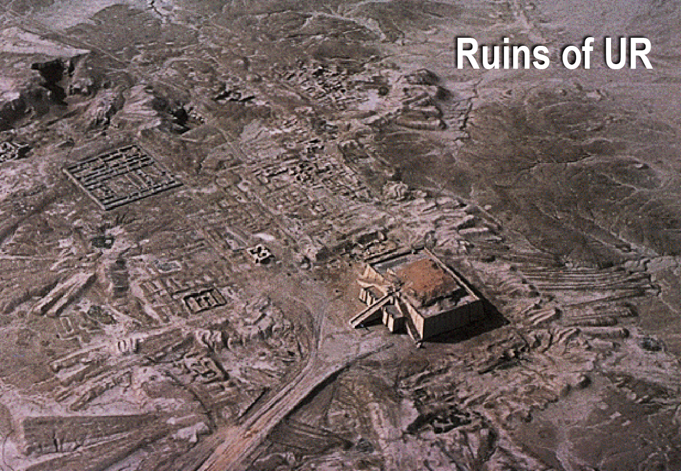
I. Abraham: A True Man of Faith.
Abraham was reared in the city of Ur (Genesis 11:27-31), in the land of the Chaldeans.

Slide 5
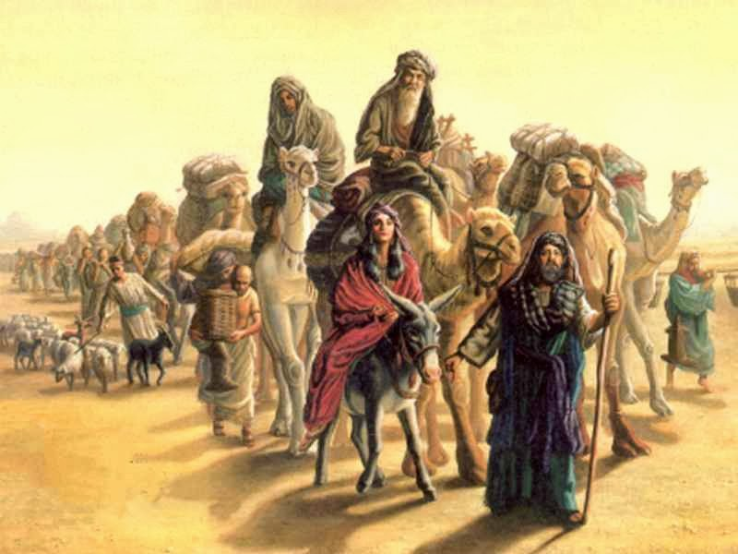
II. God’s Call –
According to Stephen, God called Abraham to leave his family while he was still living in Ur.
Acts 7:2-4
Genesis 12:1

Slide 6
III. Abraham’s Response –
How did Abraham respond?
Hebrews 11:8
Disobedience is the fruit of disbelief
Genesis 3:1-5

Slide 7
III. Abraham’s Response –
We must learn to live by faith.
Heb 3:12-14
Heb 3:18-19
Was his faith blind?
Prov 3:5-7

Slide 8
III. Abraham’s Response –
Abraham was called to leave behind what he was most familiar with
Rom 6:2b-7
Rom. 12:2
2 Cor. 6:14
1 John 2:15

Slide 9
IV. Lessons from the Life of Abraham
Abraham was a man of sacrificial selflessness.
Abraham was a man of conviction.
Abraham was a man of faith, or trust.
Abraham provides a magnificent example of what constitutes true loyalty to God.

Slide 10
Conclusion
We too can be characterized as “the friend of God” (James 2:23)
Let us “walk in the steps of that faith of our father Abraham” (Romans 4:12)
God will give us an eternal victory far more marvelous and grand than we can now imagine.

