Slide 1
God’s Promises to Abraham – Part One
Genesis 12:1-3

Slide 2
INTRODUCTION
The words God spoke to Abram here form a spiritual foundation for our understanding of the rest of the scriptures.
We need to understand how God fulfilled His promises to Abram (later Abraham).

Slide 3
I. Elements of the Promise:
3 interrelated promises
  A nation
  A land
  An offspring

Slide 4
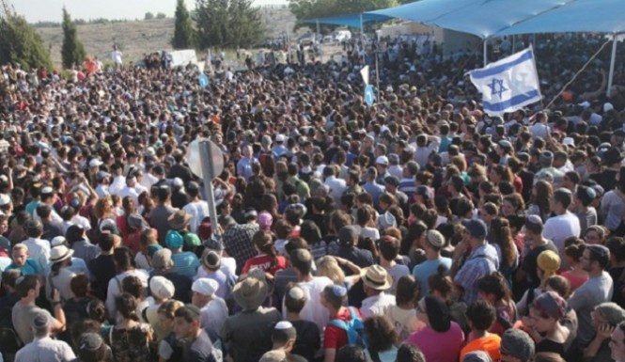
I. Elements of the Promise:
A Great Nation
Genesis 12:2
Deuteronomy 1:10
2 Samuel 7:23

Slide 5
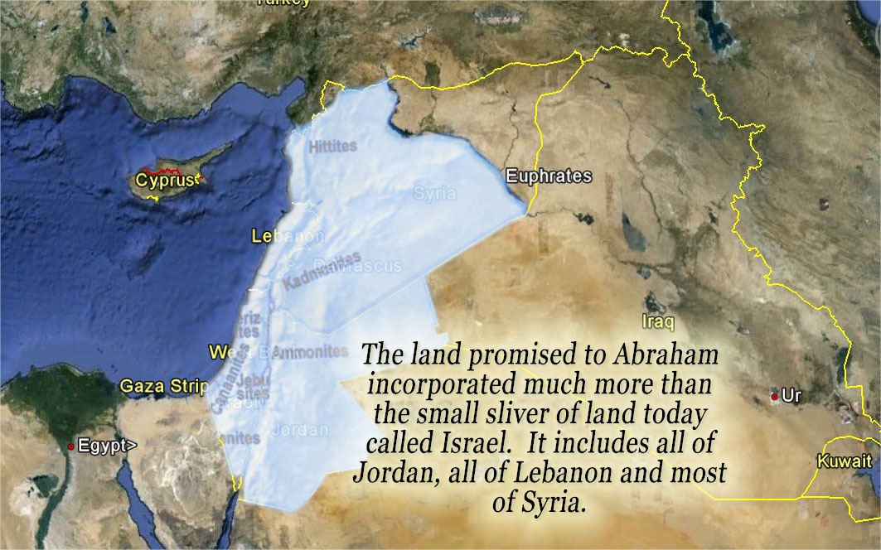
I. Elements of the Promise:
The Land of Canaan
Genesis 13:14-15
Genesis 15:18-21

Slide 6
I. Elements of the Promise:
The Offspring
Genesis 22:18
Galatians 3:16

Slide 7
II. Fulfillment of Promises:
It is crucial that we understand the manner in which God fulfilled the promises He made to Abram in Genesis 12.
Much false doctrine, especially the false teachings of pre-millennialism, has their roots in a misinterpretation of these promises, and a failure to recognize their proper fulfillment.

Slide 8
II. Fulfillment of Promises:
Pre-millennialism alleges that Jesus will return to this earth before he commences a thousand-year reign on David’s throne in Jerusalem.
Dispensationalists also allege that in the “seven-year tribulation period,” just prior to Christ’s “millennial reign,” God will restore the Jews to Palestine, and a national conversion of the Hebrew people will occur.

Slide 9
II. Fulfillment of Promises:
A careful consideration of the Bible text will indicate that God fulfilled every physical element of the promises He made to Abraham.
Galatians 3:26-29

Slide 10
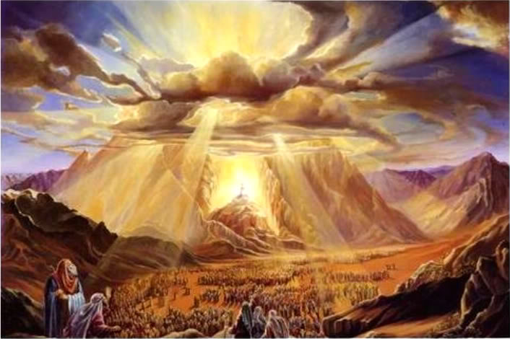
II. Fulfillment of Promises:
A special covenant relationship was driven by the law given at Sinai, and predicated on their keeping of that law.
Deuteronomy 4:6-8

Slide 11
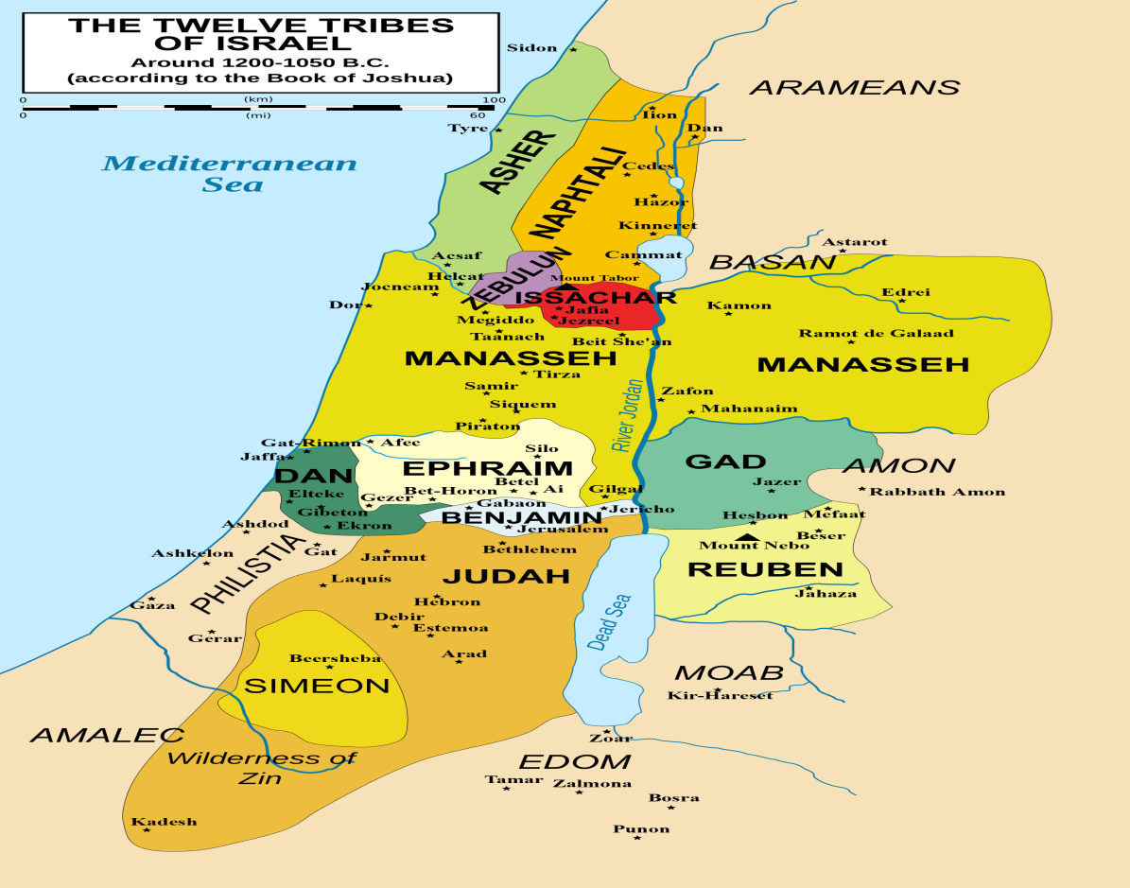
II. Fulfillment of Promises:
God gave all the land He promised – Scriptures clearly refute all of the present “land claims” of the pre-millennialists.
Joshua 21:43-45

Slide 12

II. Fulfillment of Promises:
The retention of the land was conditional on their faithfulness.
Joshua 23:11-16

Slide 13
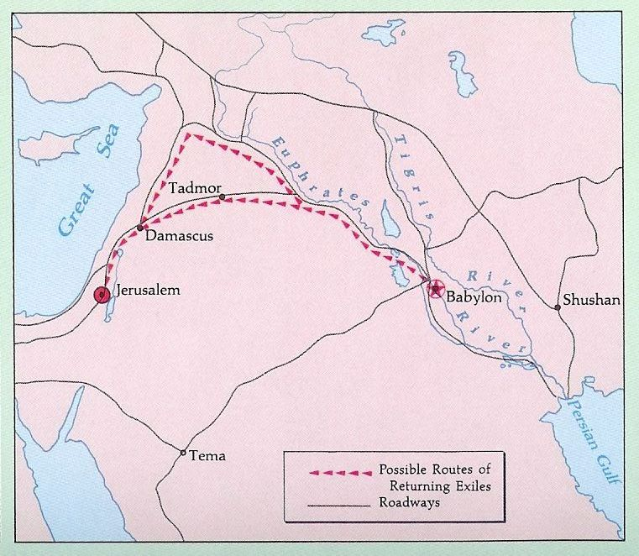
II. Fulfillment of Promises:
God returned a remnant to the land
Jeremiah 29:10

Slide 14
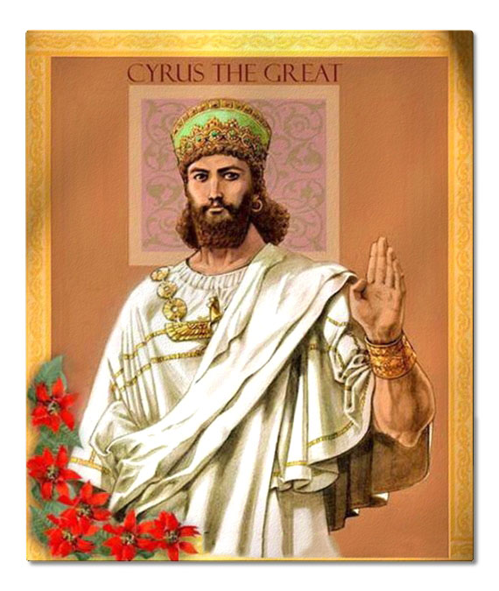
II. Fulfillment of Promises:
Jeremiah’s prophecy was fulfilled in the days of Cyrus, king of Persia, through the work of Ezra & Nehemiah.
Ezra 1:1

Slide 15
II. Fulfillment of Promises:
Other predictions, which speak of a “restoration” of Israel, refer to a spiritual restoration (to God, not Palestine— such as Isaiah 49:6-9; where Isaiah speaks of Jehovah’s Servant (the Messiah) restoring Israel and blessing all nations.
Paul references this passage twice (2 Cor. 6 & Acts 13 in Antioch) in connection with the preaching of the gospel to both the Jew and the Gentile.

Slide 16
Conclusion
God promised Abraham:
A nation
A land
An offspring
God fulfilled these promises in the nation of Israel, the promised land and Jesus Christ.

